Slide 1
Metadata and Reproducibility

Slide 2
Science as a second thought
Formulate a theory Gather data Learn about data storage Learn about data movement protocols Lose data Check out of rehab Learn about backup and replication Gather data Learn about versioning Start preliminary analysis Buy a newer laptop Buy more memory Buy a desktop with more memory | Buy a bigger monitor & GPUs “for work” Google “250GB Excel Spreadsheet” Learn about batch processing Learn about batch schedulers Learn about patience. Learn more about data storage Learn about distributed systems. Go back through notes to remember the science question. | Learn R & Python Learn linux admin Finish preliminary analysis. Grow a ponytail Write a paper. Learn about data publishing Learn about reproducibility Plot the death of your advisor/dept. head Apply for grants & research allocations on public systems Wait to apply next time Finish analyzing data Reformulate your theory Goto 1

Slide 3

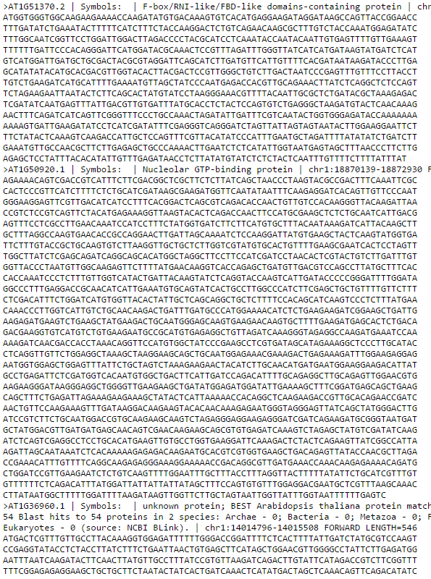
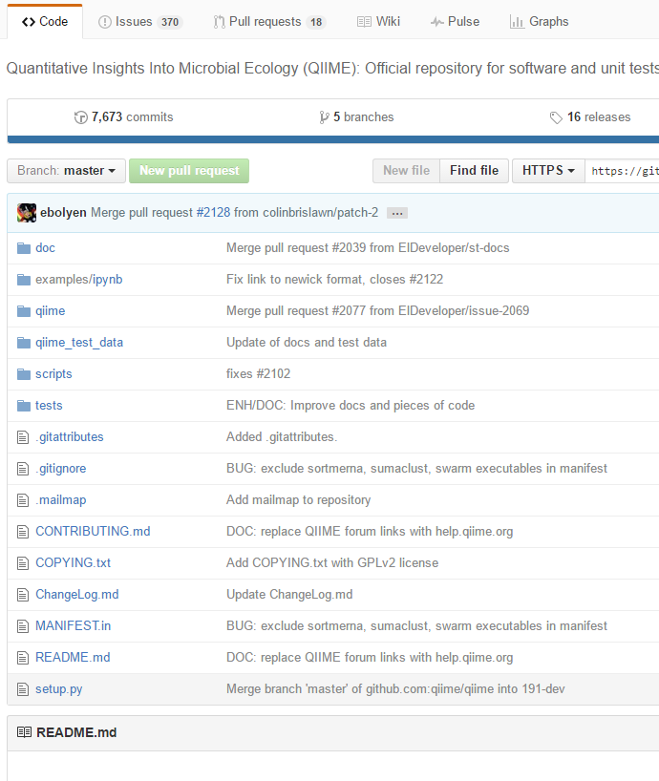
Scientific reproducibility
+
+
Notes:
Traditionally, the Methods section of a paper captured the process
In computation, we commonly have the methods section + the raw input data
Enterprising students add source code

Slide 4
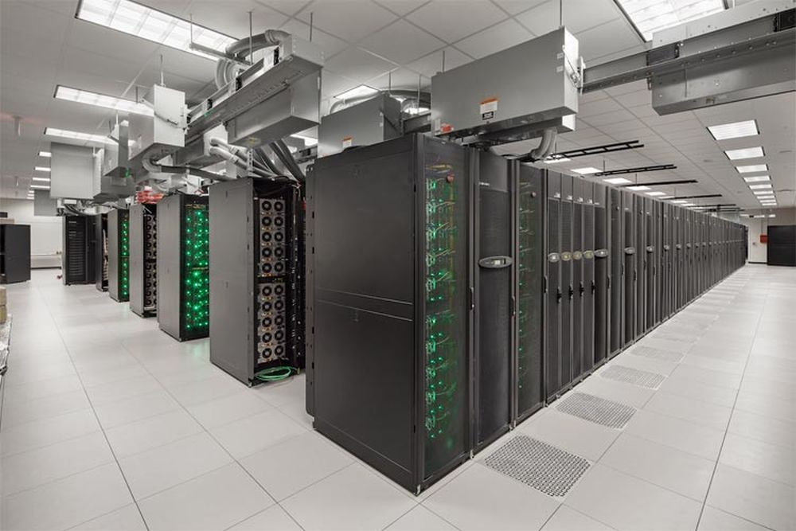

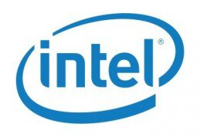


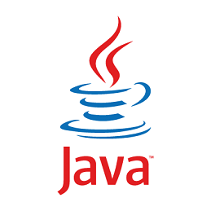



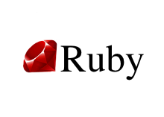
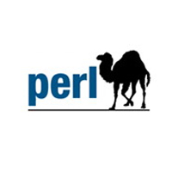

Some assembly required…
?
?
?
?

Slide 5
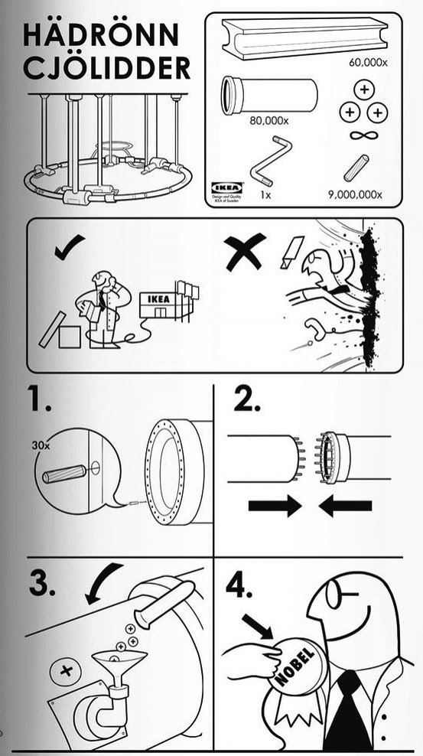

Slide 6

Scientists, with few exceptions, are not trained programmers
Research is hard
Coding is hard
Research code is
well designed,
documented,
leverages design patterns,
highly reusable,
portable,
and usually open source.

Slide 7
Accessibility >= Capability
For scientific reproducibility, the impact of your work will be more about accessibility than capability
Domain grad students, not sys admins, are the early adopters
Where can we focus effort to create community around capability?

Slide 8


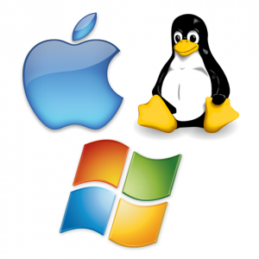
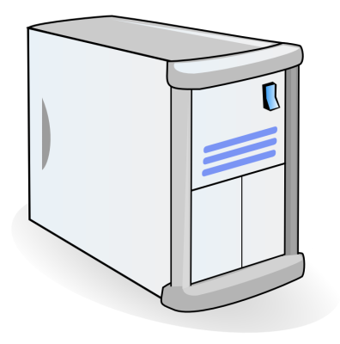
What has changed the least about the computation you do over the last 10 years?
What do we ask domain researchers to learn to use our tools and data?
Interface
Applications
Operating System
Memory/CPU/Disk

Slide 9
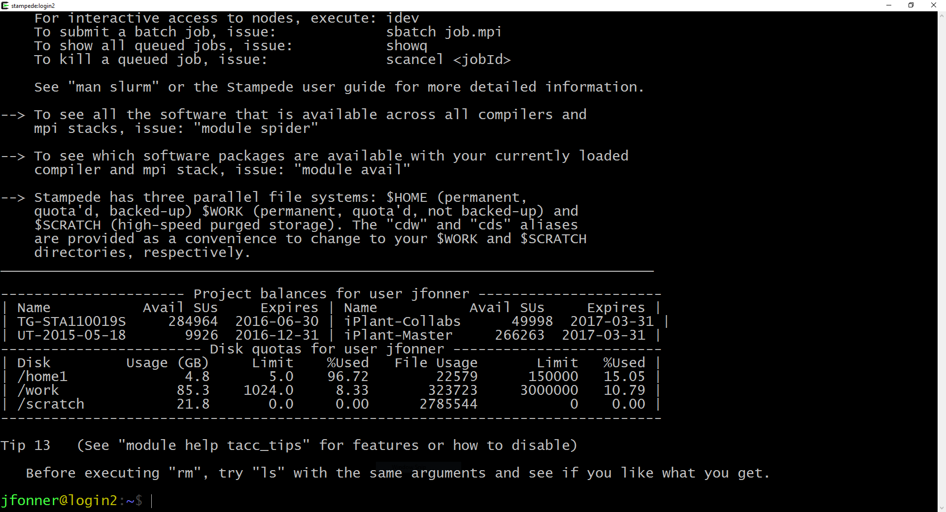

Slide 10
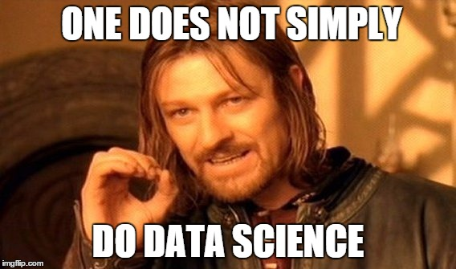

Slide 11
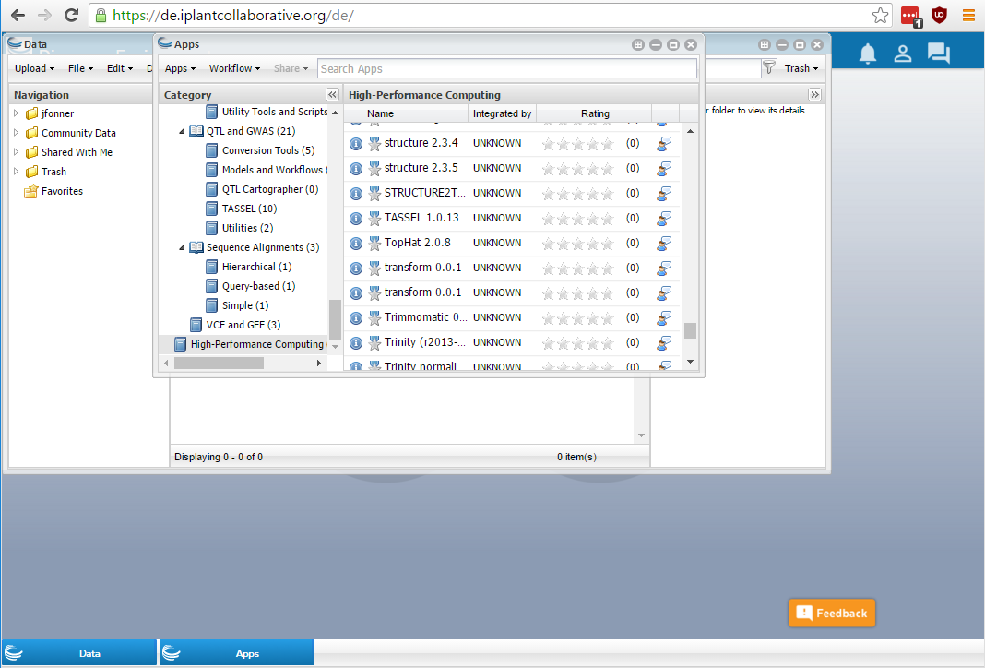

Slide 12
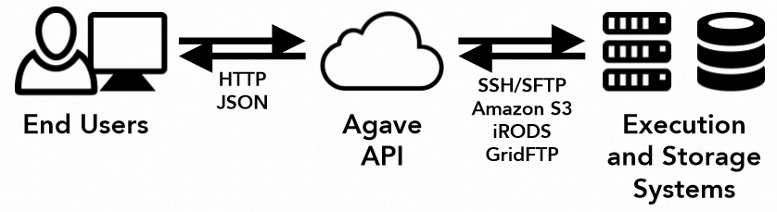
Decoupling the technology “stack”
“Reproducers” Web Browser GUIs Windows / Mac OS Support Sample Data and Sample Workflows | “Producers” Linux CLI Hadoop / GPFS / Lustre Clusters / Clouds / Containers Dockerfile / Makefile / Ansible

Slide 13
backend infrastructure: Systems
Categorize systems as either Storage or Execution
Describe and support relevant protocols, directories, schedulers, and quotas
Each system includes the credentials to log into the system (SSH Keys, X509, username/password)
Register everything with a JSON document
http://agaveapi.co/documentation/tutorials/system-management-tutorial/

Slide 14
Backend infrastructure: Apps
An “App” is a versioned instance of a software package on a specific Execution System
App assets are bundled into a directory and stored on a Storage System
Apps can be private, shared with individual users, or made public
Public apps are compressed, assigned a checksum, and stored in a protected space
http://agaveapi.co/documentation/tutorials/app-management-tutorial/

Slide 15
Backend Infrastructure: Jobs
A “Job” is an execution of an App with a specific set of input files and parameters
All jobs are given an ID, all inputs and parameters are preserved, output is also tracked
Jobs can be shared with others
http://agaveapi.co/documentation/tutorials/job-management-tutorial/

Slide 16
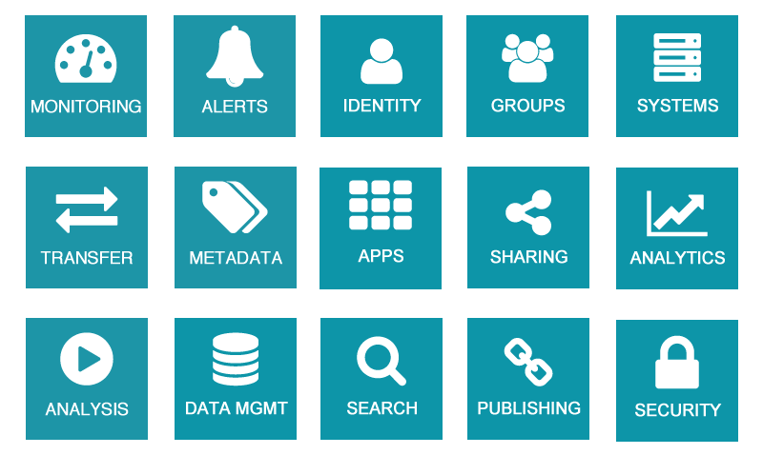

Slide 17
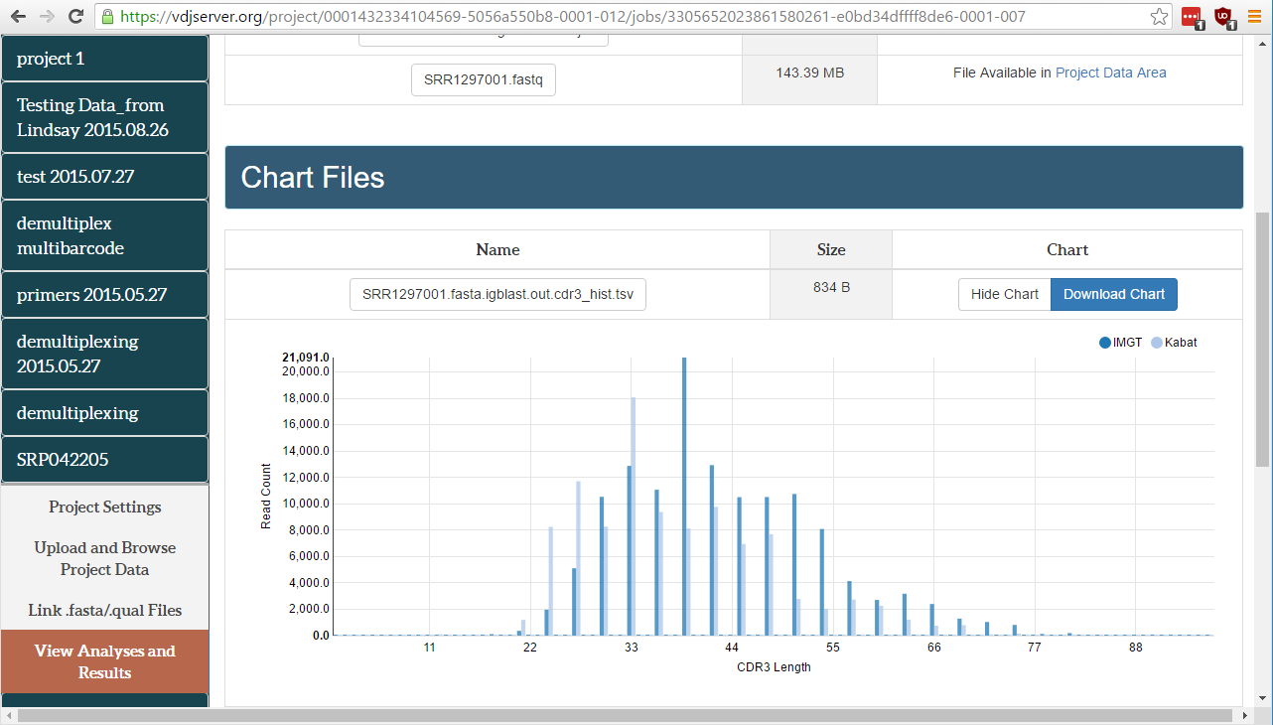
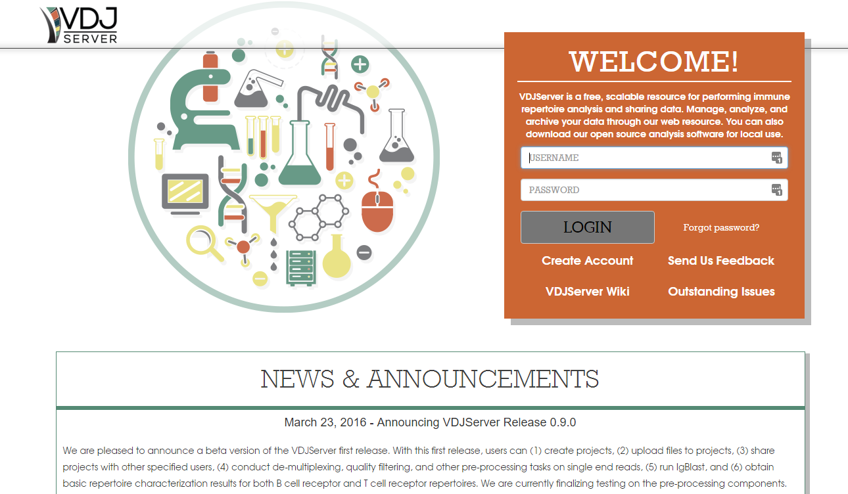

Slide 18
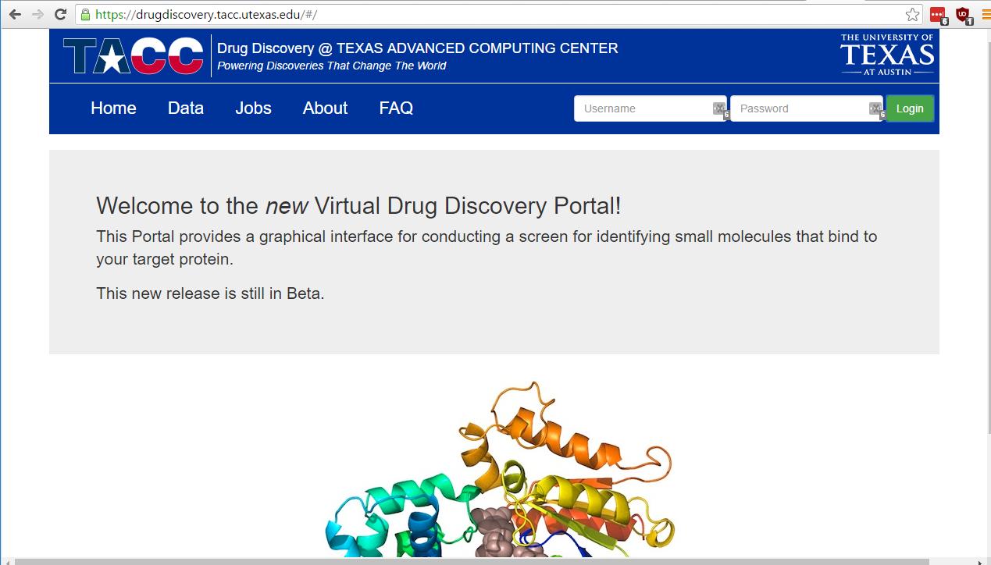

Slide 19
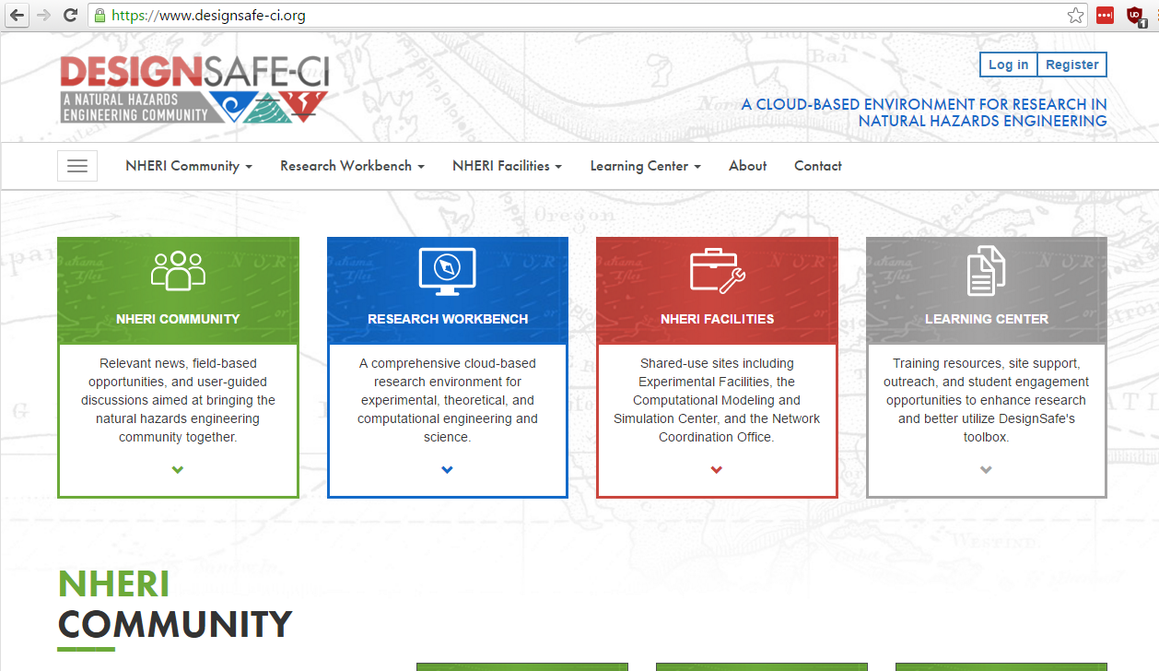

Slide 20
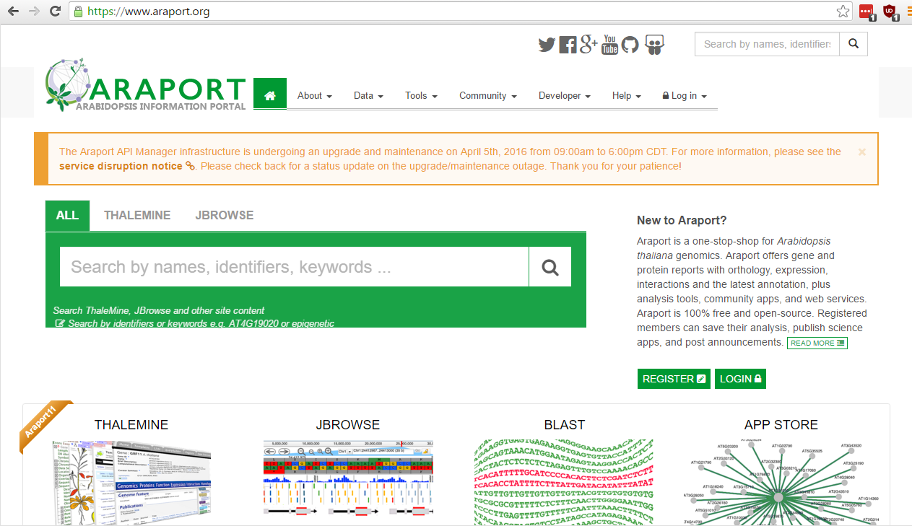

Slide 21
Developer Command-line tools
https://bitbucket.org/agaveapi/cli
Requires bash and python’s json.tool
Uses caching for authentication
Parses JSON responses to condense output
As a Linux user, this is home-sweet-home

Slide 22

What about Jupyter?
Bleeding edge research will never be on a webpage
Data exploration “outside the app” also needs to be captured
An infrastructure for responsible computing at scale inevitably must support responsible data exploration
Jupyter has broad OS support, domain adoption, domain libraries, and a more interactive UI

Slide 23
agavepy
github.com/TACC/agavepy
Pythonic wrapper for all Agave endpoints
pip install agavepy
Developers actively “dogfooding” the module
(Obviously) usable within Jupyter
Has had greater uptake by users (not just developers)

Slide 24
Agave-aware jupyterHub
Going one step further – give users a notebook
jupyter.public.tenants.prod.agaveapi.co/
(Free) account creation here: public.tenants.prod.agaveapi.co/create_account
Beta implementation at the moment
data purges during updates
Limited capacity on the current VM
All notebooks run inside Docker containers

Slide 25
What’s next?
Full-featured developer portal
Open-source reference implementation of an Angular Javascript portal built on Agave
Additional Jupyter notebook examples
Production-grade support for a hosted JupyterHub

